Slide 1
Lecture: Graph Traversals (BFS, DFS)

Slide 2
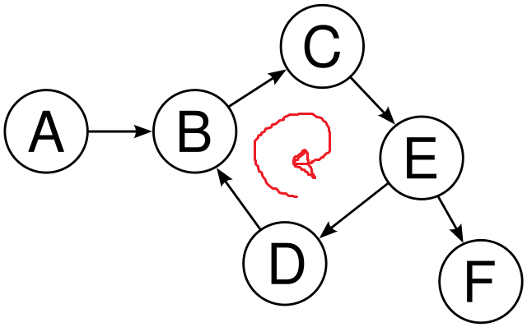
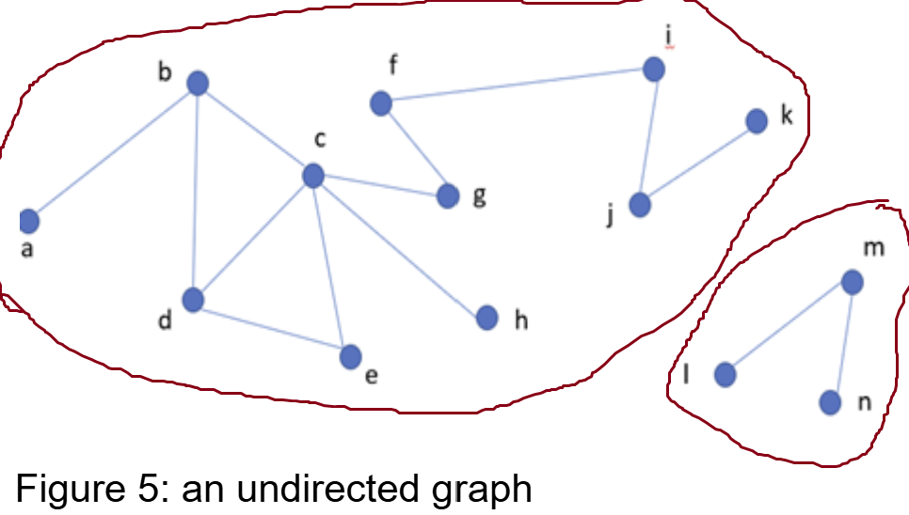
Graph traversals
Graph Traversal Purpose:
Given a graph G=(V,E) and a starting vertex s
Visit each vertex v∈V exactly once
Difference from Trees:
Graphs may contain cycles → risk of infinite recursion.
Graphs may be disconnected → not all vertices are reachable from one source.

Slide 3
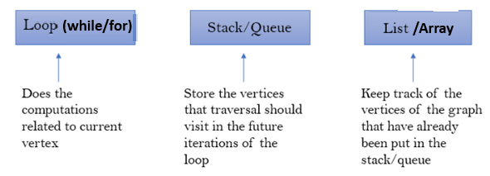
Graph traversals
Difference from Trees:
Graphs may contain cycles → risk of infinite recursion.
Graphs may be disconnected → not all vertices are reachable from one source.
Solution: Use while loops, a stack/queue, and a visited list to track progress.

Slide 4
Graph traversals [general structure]
Traversal Process: 1. Insert starting vertex into stack/queue and visited list.
2. Loop until stack/queue is empty:
Remove vertex from stack/queue.
Process the vertex.
Add unvisited neighbors to stack/queue and visited list.
Disconnected Graphs: After traversal, check for unvisited vertices and repeat from them.

Slide 5

Graph traversals
Two common graph traversal algorithms: BFS & DFS
Breadth-First Search (BFS) Start with the source vertex Explores breadth-first (level-wise), visiting all neighbors at the current level before moving to the next. Uses Queue (FIFO) | Depth-First Search (DFS) Start with the source vertex Explores depth-first, following one path as far as possible before backtracking when all neighboring nodes have been visited (no further choices remain). Recursively visit each neighbor (Recursive call stack) Uses Stack (LIFO)

Slide 6
Vertex Selection Rules in Traversal
Alphabetical options: Choose the alphabetically closest.
Numerical options: Follow stated order (ascending/descending).
No order given / mentioned: Select any option (any neighboring node you want).

Slide 7
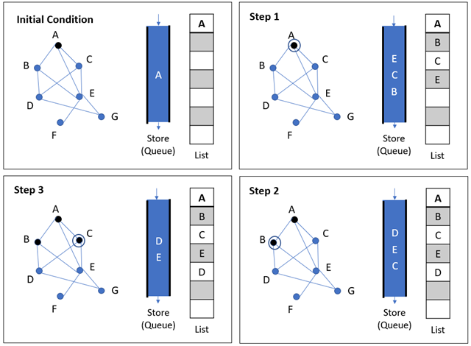
Breadth-first search (Simulation 1)
Here, front of queue is at the bottom.
Dequeue from bottom (front), enqueue from top (rear).
Source: https://www.tutorialspoint.com/data_structures_algorithms/

Slide 8
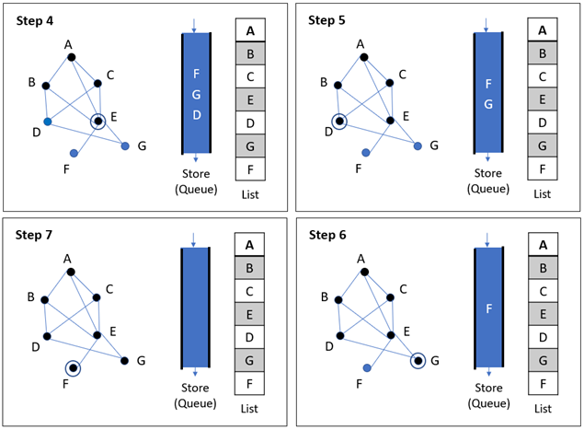
Breadth-first search (Simulation 1)
Here, front of queue is at the bottom.
Dequeue from bottom (front), enqueue from top (rear).
Source: https://www.tutorialspoint.com/data_structures_algorithms/

Slide 9
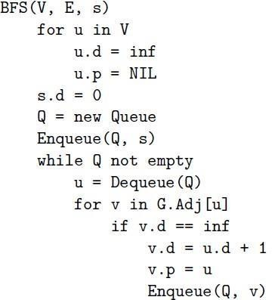
Breadth first search (BFS)
d [u ]: the distance from source
π[u ] or p[u ]: the predecessor of u

Slide 10
Breadth first search (BFS)
Information during traversal
color [u]: the color of each vertex visited (For skipping visited nodes)
white: undiscovered
gray: discovered but not finished processing
black: finished processing
π[u ] or p[u ]: the predecessor of u
d [u ]: the distance from source

Slide 11
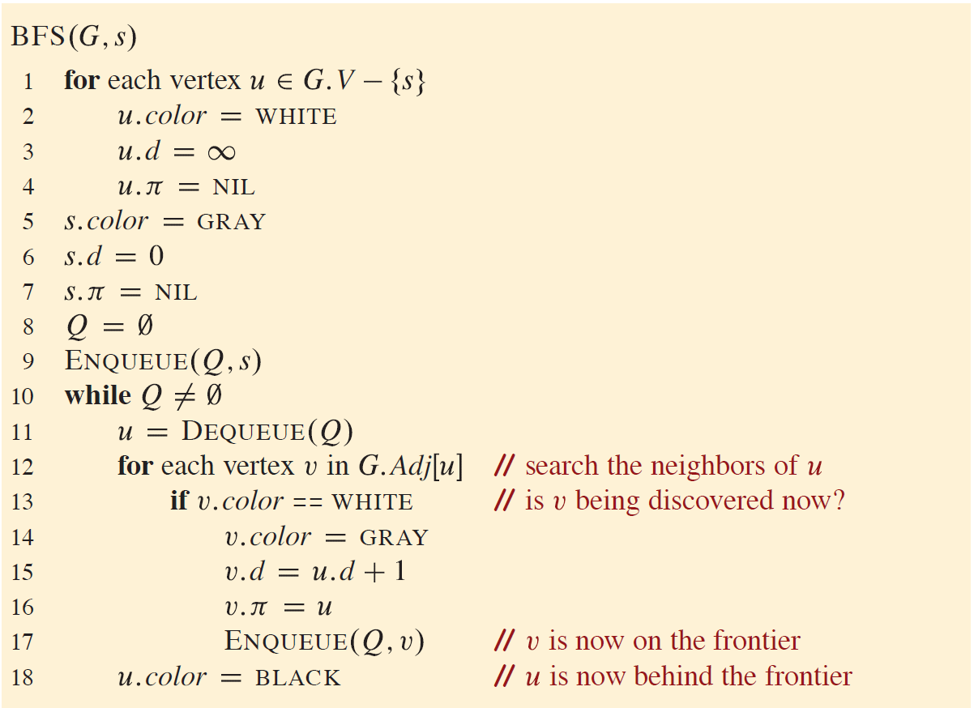
Breadth first search (BFS) another version

Slide 12
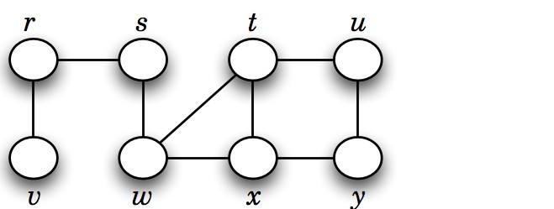
Basic idea behind breadth first search (BFS)
Given a graph G = (V , E ), and a distinguished vertex s (source), systematically visit each vertex v ∈ V that is reachable from s.
Builds a BFS tree over the graph starting from a source vertex.

Slide 13
Breadth-first search (Simulation 2)

Slide 14
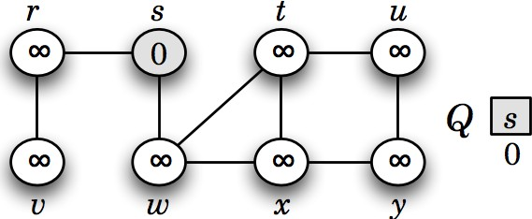
Breadth-first search (Simulation 2)
Here, front of queue is on left side. Hence, dequeue from left (front) and enqueue from right (rear of queue)

Slide 15
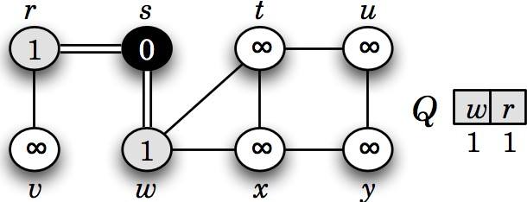
Breadth-first search (Simulation 2)
Here, front of queue is on left side. Hence, dequeue from left (front) and enqueue from right (rear of queue)

Slide 16
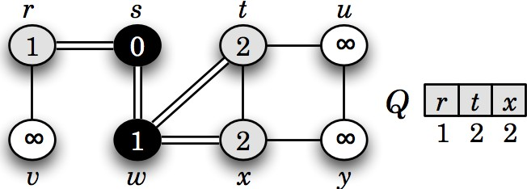
Breadth-first search (Simulation 2)
Here, front of queue is on left side. Hence, dequeue from left (front) and enqueue from right (rear of queue)

Slide 17
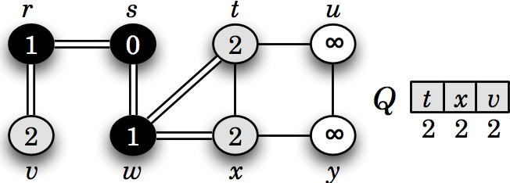
Breadth-first search (Simulation 2)
Here, front of queue is on left side. Hence, dequeue from left (front) and enqueue from right (rear of queue)

Slide 18
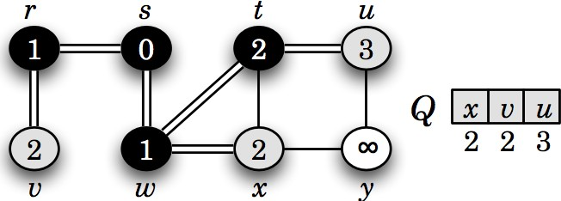
Breadth-first search (Simulation 2)
Here, front of queue is on left side. Hence, dequeue from left (front) and enqueue from right (rear of queue)

Slide 19
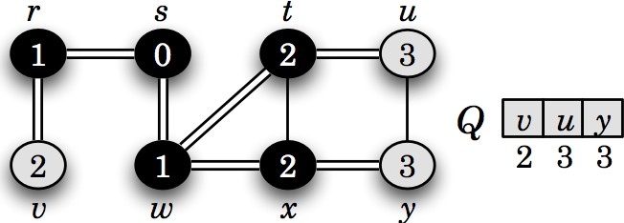
Breadth-first search (Simulation 2)
Here, front of queue is on left side. Hence, dequeue from left (front) and enqueue from right (rear of queue)

Slide 20
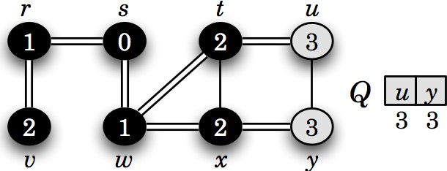
Breadth-first search (Simulation 2)
Here, front of queue is on left side. Hence, dequeue from left (front) and enqueue from right (rear of queue)

Slide 21
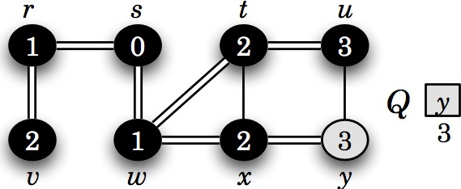
Breadth-first search (Simulation 2)
Here, front of queue is on left side. Hence, dequeue from left (front) and enqueue from right (rear of queue)

Slide 22
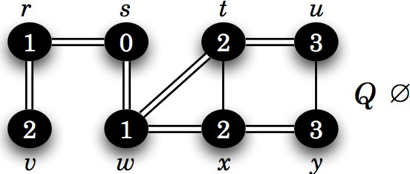
Breadth-first search (Simulation 2)
Here, front of queue is on left side. Hence, dequeue from left (front) and enqueue from right (rear of queue)

Slide 23
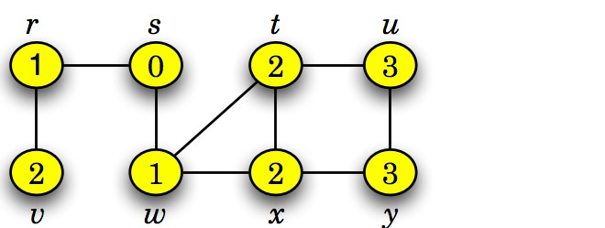
Breadth first search (BFS)
This graph G = (V , E ) is connected, since BFS visits all vertices v ∈ V starting from s.
BFS also finds the shortest path (fewest edges) from s to any other vertex t.

Slide 24
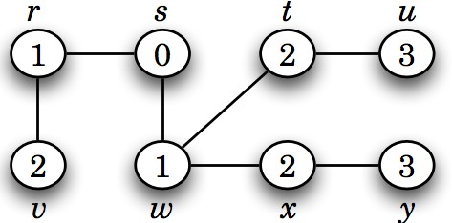
Breadth first search (BFS) Tree
A BFS tree is a tree formed during BFS that shows the shortest paths (in terms of edges) from the source vertex to all other reachable vertices in the graph.

Slide 25
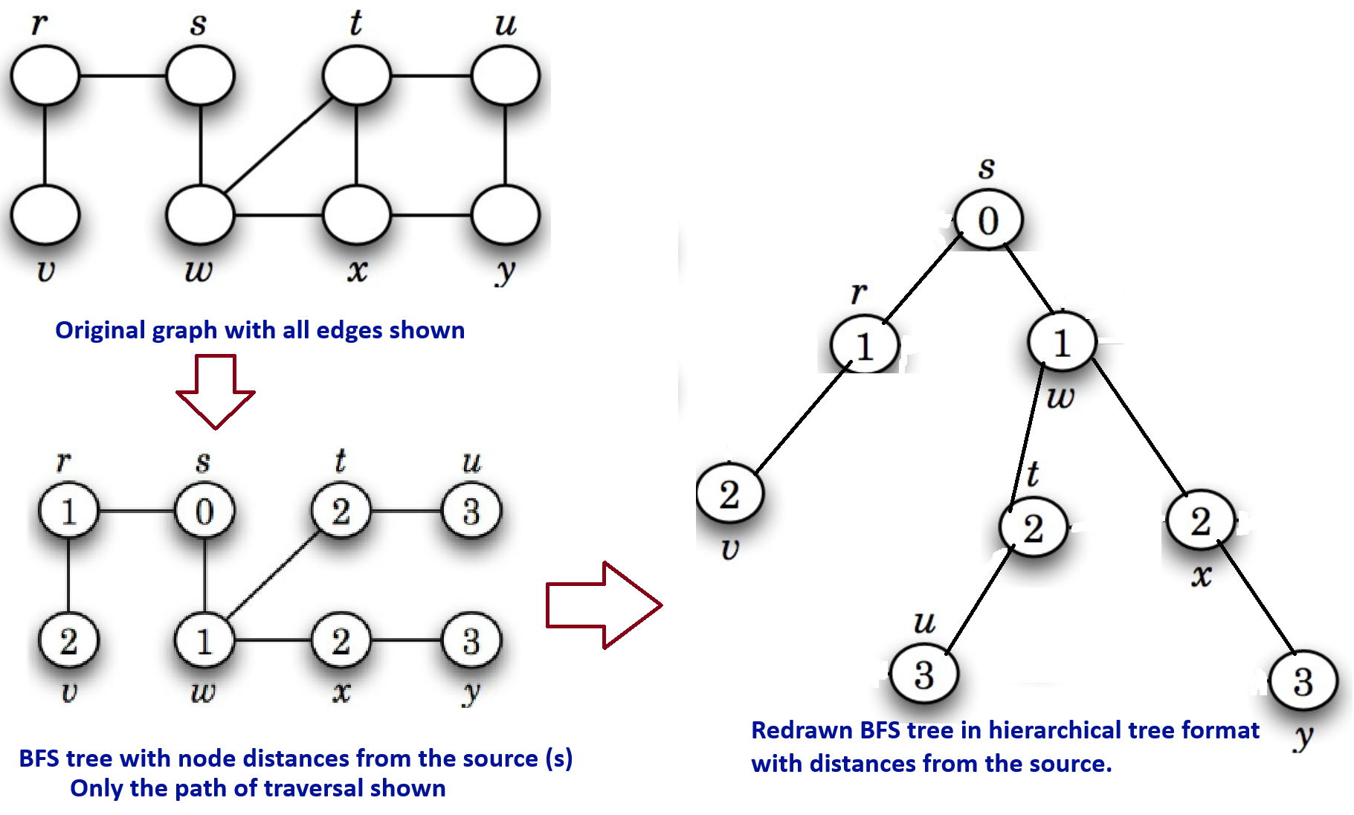
Breadth first search (BFS) Tree

Slide 26
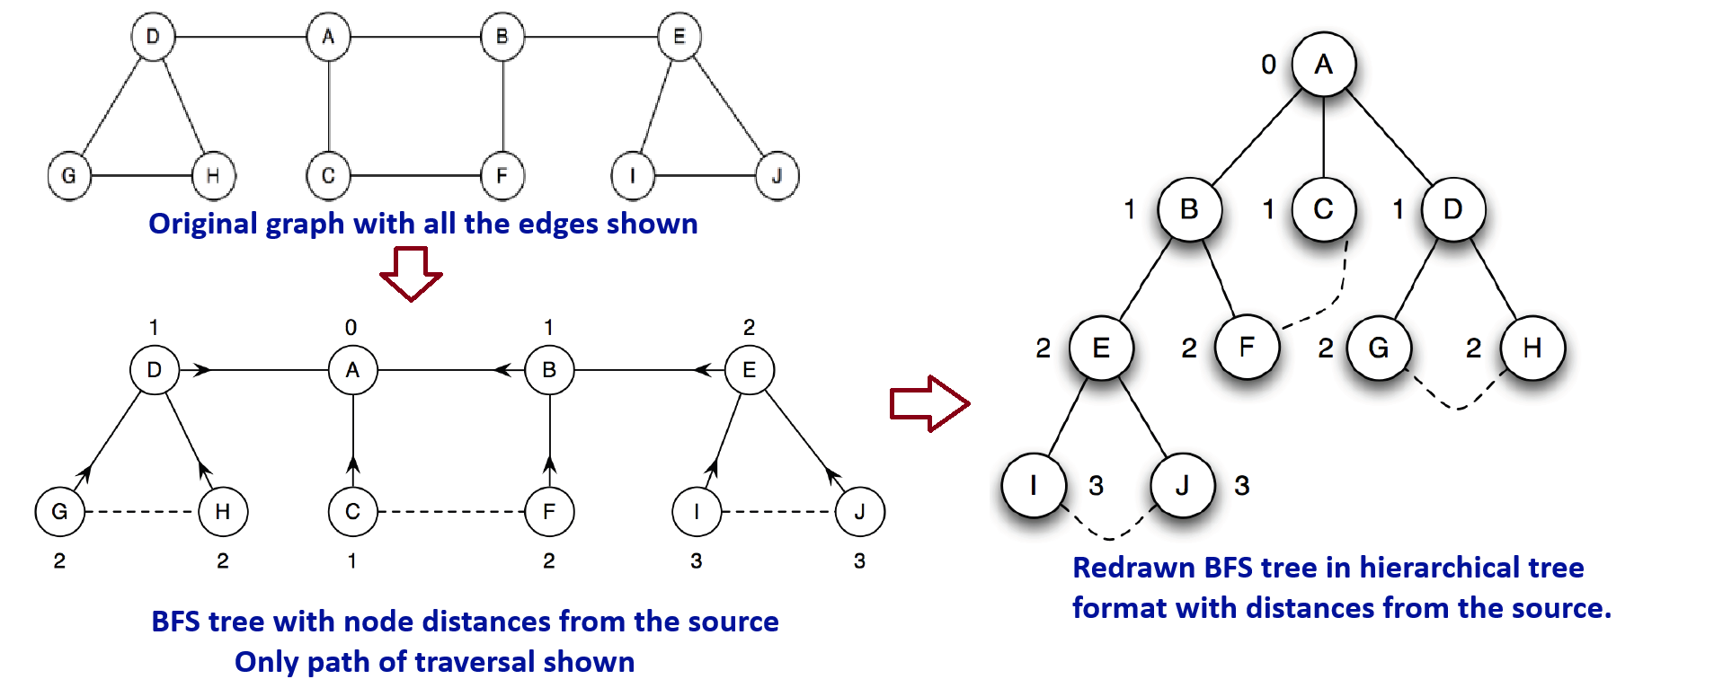
Breadth first search (BFS) Tree
Vertices are labeled with their distance from the source.
Arrows point to each vertex’s ancestor.
Solid lines = tree edges;
dashed lines = non-tree (back) edges in this undirected graph

Slide 27
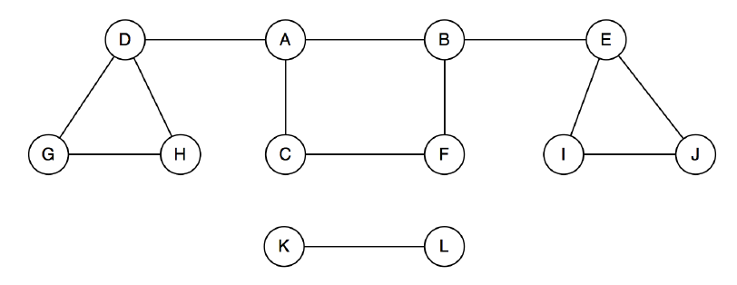
Breadth first search (BFS)
A single BFS from vertex A only visits vertices in its connected component.
Vertices K and L are not visited if they are not reachable from A.
To visit all vertices, perform BFS from each unvisited vertex in the graph.
This approach identifies all connected components in the graph.

Slide 28
Breadth-first search - Analysis
Time Complexity of BFS
Outer while loop processes nodes from the queue
Inner for loop examines all adjacent neighbors
At first glance, this may look like nested loops (suggesting higher complexity)
Nesting does not multiply time by V × E independently

Slide 29
Breadth-first search - Analysis
Time Complexity of BFS
Outer While Loop – Node Processing
Each node enqueued & dequeued once → O(V)
Inner For Loop – Edge Processing
Directed Graph: Each edge explored once → O(E)
Undirected Graph: Each edge explored twice → O(2E) ≈ O(E)
So, Time Required: O(E)
Overall Complexity
Node processing = O(V)
Edge processing = O(E)
So, Total = O(V + E) (best, average, worst cases)

Slide 30
Breadth first search (BFS) Algorithm with explanation
BFS(G, s) // G = (V, E), s is the source vertex 1. for each vertex u in V: 2. u.d = ∞ // Set distance to infinity 3. u.p = NIL // Set parent to NIL 4. s.d = 0 // Set the distance of the source vertex to 0 5. Q = new Queue // Initialize an empty queue 6. Enqueue(Q, s) // Enqueue the source vertex 7. while Q is not empty: 8. u = Dequeue(Q) // Remove the front vertex from the queue 9. for each vertex v in Adj[u]: 10. if v.d == ∞: // If vertex v has not been visited 11. v.d = u.d + 1 // Set the distance of v 12. v.p = u // Set parent of v to u 13. Enqueue(Q, v) // Enqueue vertex v

Slide 31
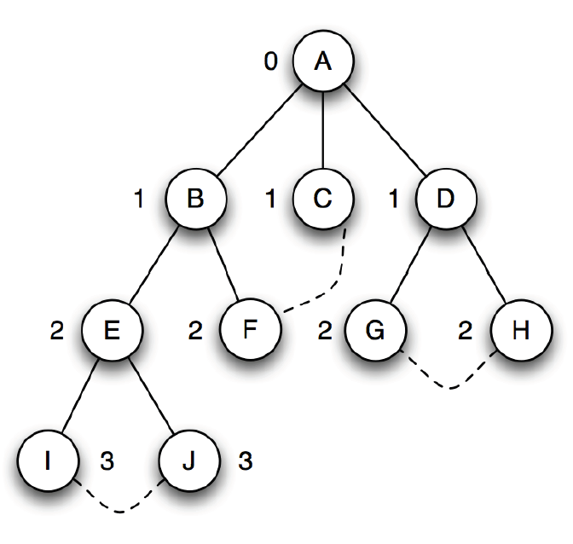
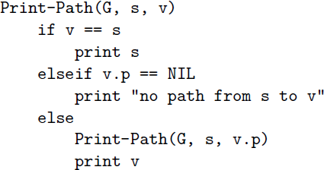
Breadth-first search - Printing a path from s to v
After BFS, we get a BFS tree where each path from the root to a node shows the shortest path in G.
This tree shows how each vertex was reached from the source.
The predecessor info (u.π) stores the previous node on the path.
Using this info, we can easily reconstruct or print the path from the source s to any node v.

Slide 32
Breadth-first search - Printing a path from s to v
BFS tree shows how each vertex was reached from the source.
The predecessor info (u.π) stores the previous node on the path.
Using this info, we can easily reconstruct or print the path from the source s to any node v.

Slide 33
Applications of BFS (Just know that these can be done)
Shortest Path (Unweighted Graph): Finding the shortest path in undirected or directed unweighted graphs using level-order traversal.
Bipartiteness Check: Verifying if a graph can be divided into two disjoint sets using two-coloring.
Cycle Detection (Undirected Graph): Detecting cycles by checking for back edges during traversal.
Graph Connectivity: Checking whether all vertices are reachable from a given starting point. Implementation will be covered in CSE221

Slide 34
Depth-first search
Starts from an initial vertex.
Recursively visits each adjacent vertex.
Strategy to search deeper into the graph, unlike BFS which fans out.
It explores edges from the most recently discovered vertex with unexplored edges.
After all edges of a vertex are explored, it backtracks to its parent.
If any vertices remain undiscovered, DFS starts again from one of them.
DFS produces a depth-first forest (collection of DFS trees)/DFS tree.

Slide 35
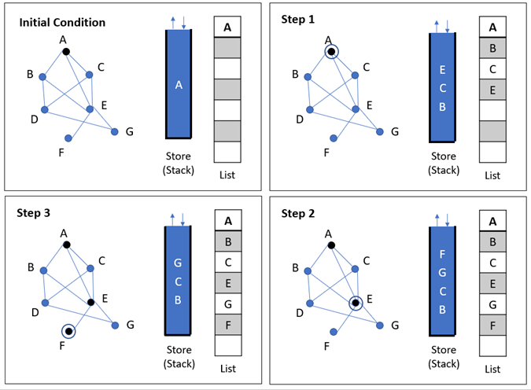
Depth-first search (Simulation 1)
Here, the top of the stack is at the upper side.
Push and pop both occur at the top.
Source: https://www.tutorialspoint.com/data_structures_algorithms/

Slide 36
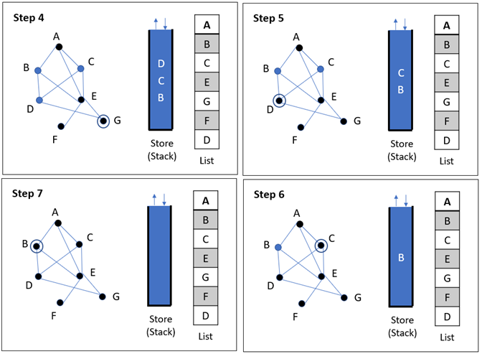
Depth-first search (Simulation 1)
Here, the top of the stack is at the upper side.
Push and pop both occur at the top.
Source: https://www.tutorialspoint.com/data_structures_algorithms/

Slide 37
Depth-first search
Information during traversal
color [u]: the color of each vertex visited
white: undiscovered
gray: discovered but not finished processing
black: finished processing
π[u ] or p[u ]: the predecessor of u
d [u ]: the discovery time (or hops from the start) IMPORTANT!!!!!
f [u]: the finish time – when processing of u and all its descendants have finished.

Slide 38
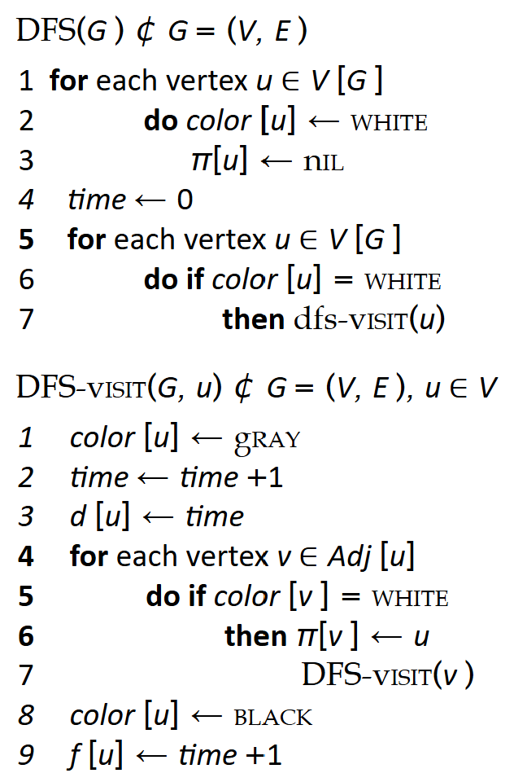
Depth-first search Algorithm

Slide 39
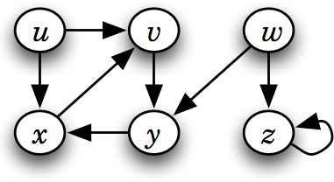
Depth-first search (Simulation 2)

Slide 40
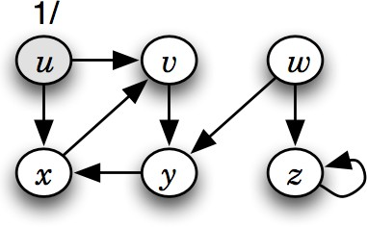
Depth-first search (Simulation 2)

Slide 41
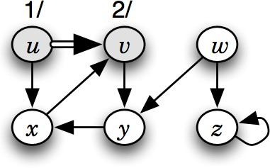
Depth-first search (Simulation 2)

Slide 42
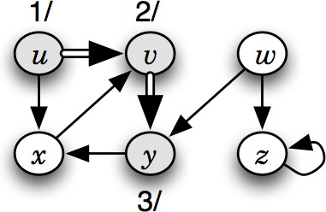
Depth-first search (Simulation 2)

Slide 43
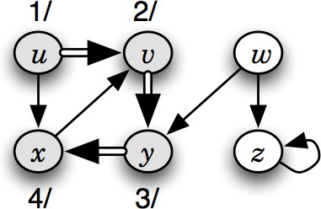
Depth-first search (Simulation 2)

Slide 44
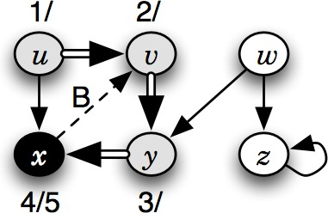
Depth-first search (Simulation 2)

Slide 45
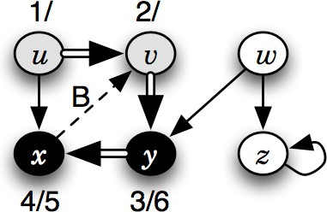
Depth-first search (Simulation 2)

Slide 46
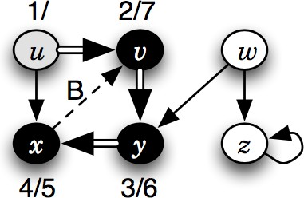
Depth-first search (Simulation 2)

Slide 47
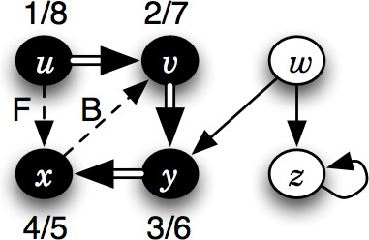
Depth-first search (Simulation 2)

Slide 48
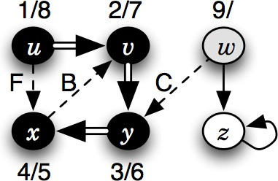
Depth-first search (Simulation 2)

Slide 49
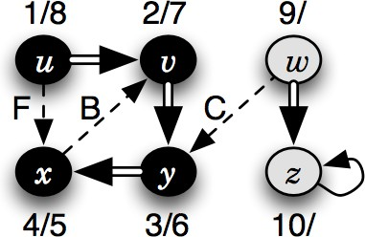
Depth-first search (Simulation 2)

Slide 50
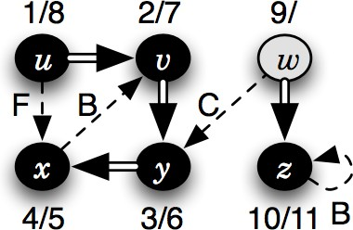
Depth-first search (Simulation 2)

Slide 51
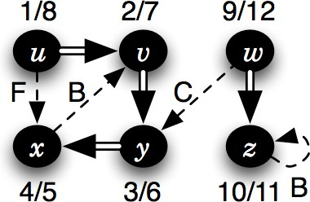
Depth-first search (Simulation 2)

Slide 52
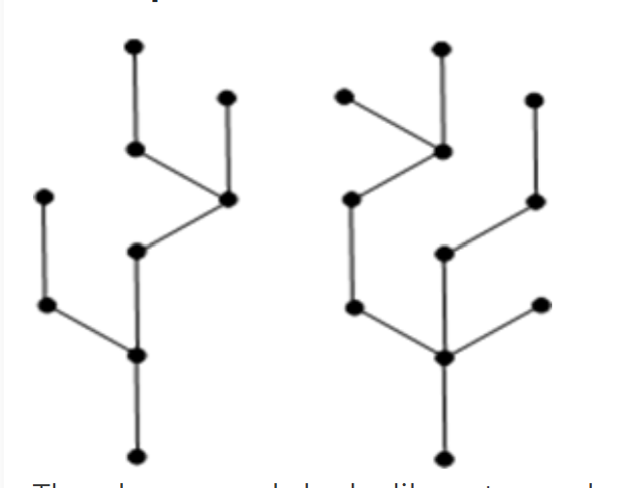
Forests (Recap from tree terminologies)
Forest: Forest is a disjoint collection of trees
The graph on left looks like a two sub-graphs but it is a single disconnected graph. There are no cycles in the above graph. Therefore it is a forest.
Trees Ch B.5, 10.4, 12.1

Slide 53
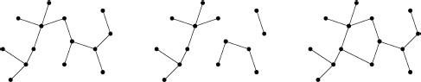
Trees and forests (Recap from tree terminologies)
Image:²
²Cormen, Leiserson, Rivest, Stein. Introduction to Algorithms, 3rd edition, MIT Press, 2009
Trees Ch B.5, 10.4, 12.1

Slide 54
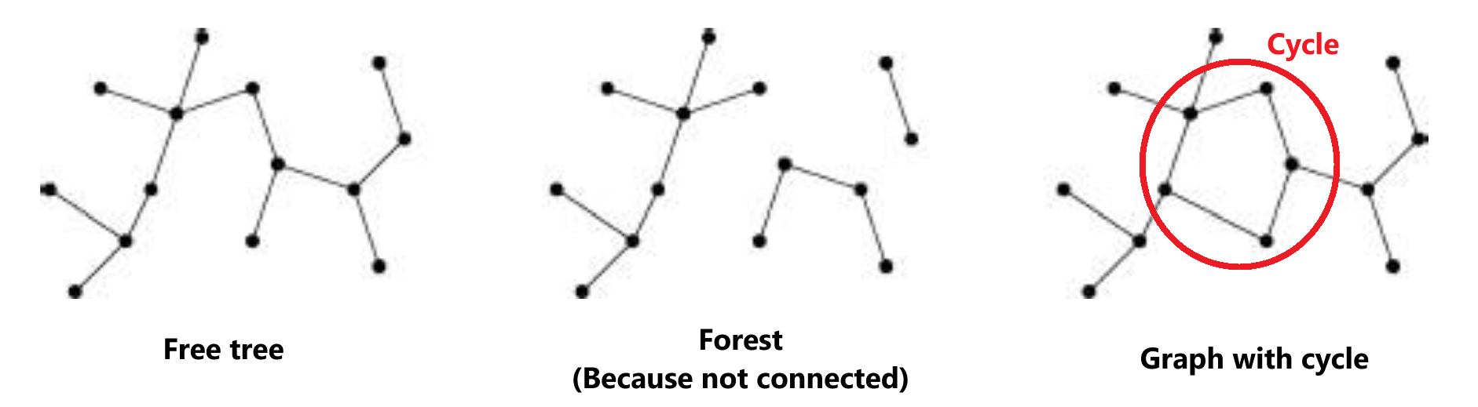
Trees and forests (Recap from tree terminologies)
Image:²
²Cormen, Leiserson, Rivest, Stein. Introduction to Algorithms, 3rd edition, MIT Press, 2009
Trees Ch B.5, 10.4, 12.1

Slide 55
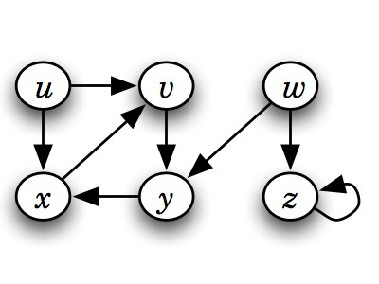
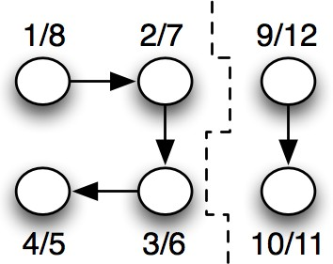
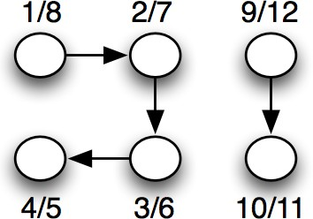
Depth-first search tree or forest

Slide 56
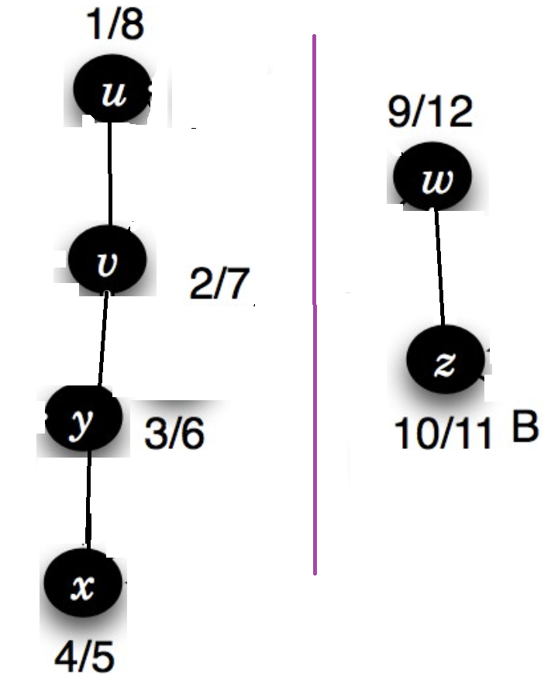
Depth-first search tree or forest

Slide 57
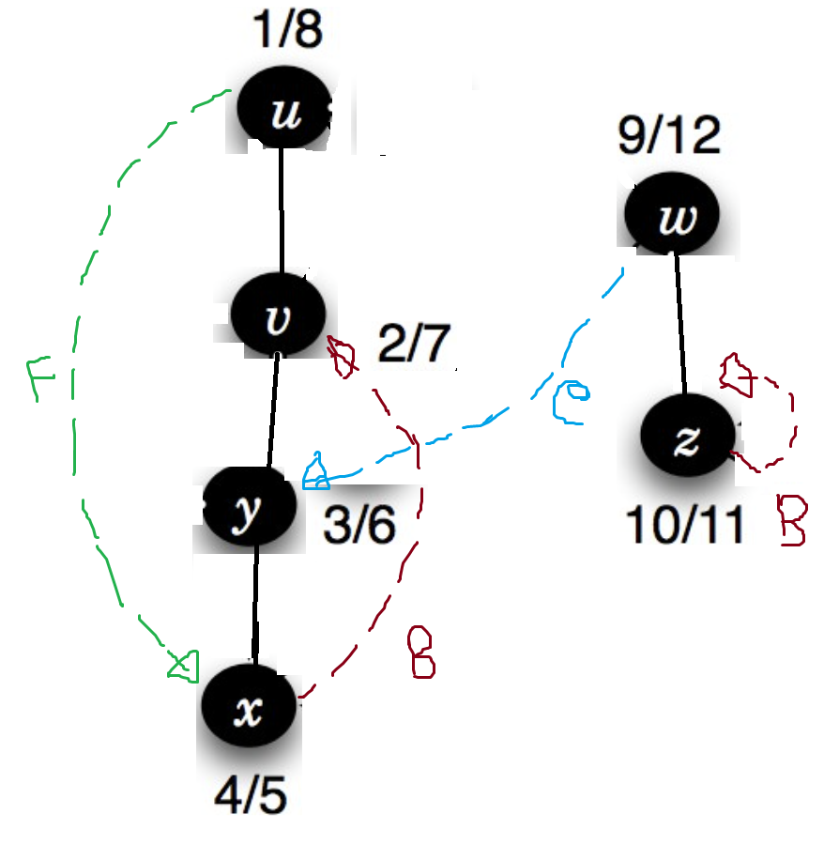
Depth-first search tree or forest

Slide 58
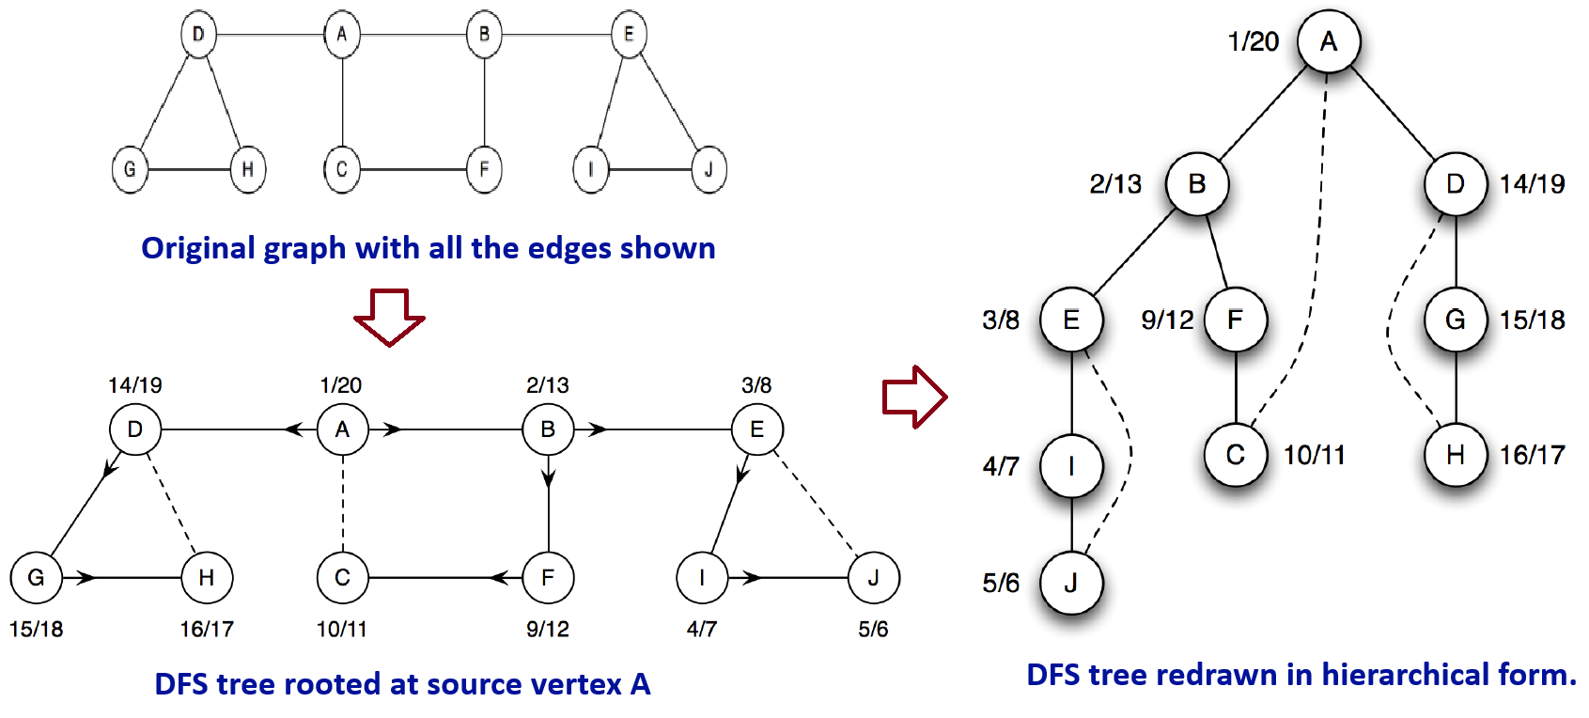
Depth-first search tree
Vertices are annotated with their discovery and finish times.
Arrows point to each vertex’s ancestor.
Solid lines → tree edges.
Dashed lines → non-tree edges (back edges in an undirected graph).

Slide 59
Depth-first search Edges (Not needed for CSE220)
DFS introduces an important distinction among edges in the original graph:
Tree edge: encounter new (white) vertex
Back edge: from descendent to ancestor
Forward edge: from ancestor to descendent
Cross edge: between a tree or subtrees
Note: tree & back edges are important; most algorithms don’t distinguish forward & cross

Slide 60
Depth-first search Edges (Not needed for CSE220)
Application of these 4 edges:
Tree edge:Connects a vertex to a newly discovered vertex, building the DFS tree.
Back edge: Points to an ancestor, identifying a cycle in the graph.
Forward edge: helps in depth classification, topological sorting, and identifying strongly connected components (SCCs).
Cross edge: Connects nodes in different DFS branches or subtrees. Details of there edges will be covered in CSE221

Slide 61
Depth-first search
A single DFS from vertex A visits only its connected component.
Vertices like K and L are not visited if they are not reachable from A.
To visit all vertices, perform DFS from each unvisited vertex.
This ensures traversal of the entire graph, including all disconnected components.

Slide 62
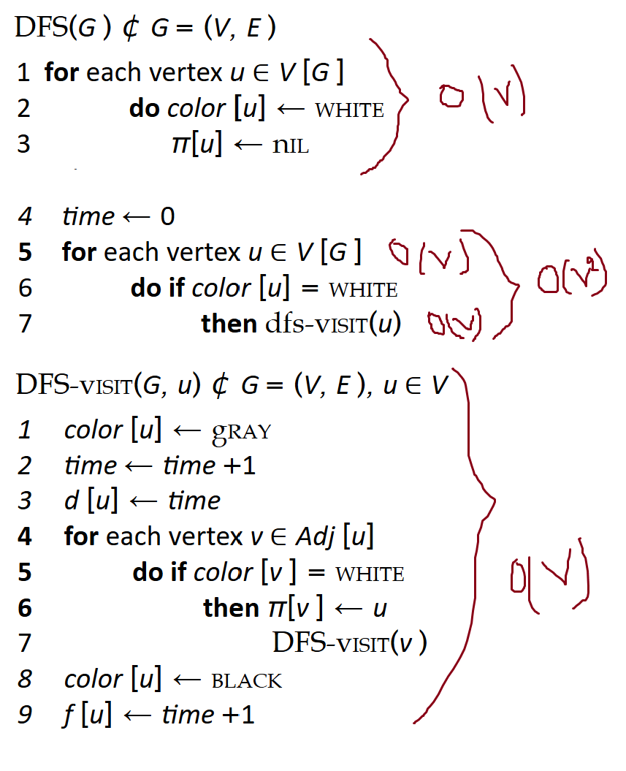
Depth-first search- Analysis
Running time: O(V²) + O(V) = O(V²)
DFS_Visit is called on each vertex
The loop over Adj[] can run up to |V| times per vertex in the worst case How many times will DFS_Visit() actually be called?

Slide 63
Depth-first search- Analysis
But often DFS is more efficient:
Node Processing:
Each node is visited exactly once
DFS_Visit() is called once per vertex
So, time required: O(V)
Edge Processing:
Directed Graph: Each edge is explored once → O(E)
Undirected Graph: Each edge is explored twice (once per endpoint) → O(2E) ≈ O(E)
So, time required: O(E)
So, total time = O(V + E) instead of O(V²)

Slide 64

Depth-first search (Simulation 3)
20/23

Slide 65

Depth-first search (Simulation 3)
20/23

Slide 66

Depth-first search (Simulation 3)
20/23

Slide 67

Depth-first search (Simulation 3)
20/23

Slide 68

Depth-first search (Simulation 3)
20/23

Slide 69

Depth-first search (Simulation 3)
20/23

Slide 70

Depth-first search (Simulation 3)
20/23

Slide 71

Depth-first search (Simulation 3)
20/23

Slide 72

Depth-first search (Simulation 3)
20/23

Slide 73

Depth-first search (Simulation 3)
20/23

Slide 74

Depth-first search (Simulation 3)
20/23

Slide 75

Depth-first search (Simulation 3)
20/23

Slide 76

Depth-first search (Simulation 3)
20/23

Slide 77

Depth-first search (Simulation 3)
20/23

Slide 78

Depth-first search (Simulation 3)
20/23

Slide 79

Depth-first search (Simulation 3)
20/23

Slide 80

Depth-first search (Simulation 3)
20/23

Slide 81

Applications of DFS (Just know that these can be done)
Topological Sorting: Ordering vertices in a directed acyclic graph (DAG).
Strongly Connected Components (SCC): Identifying subsets of vertices where every vertex is reachable from every other vertex.
Cycle Detection: Detecting cycles in directed graphs using back edges.
Path Finding: Finding paths between vertices in a graph.
Solving puzzles/mazes: Like the Knight’s Tour problem or Sudoku.
Implementation will be covered in CSE221
20/23

Slide 82
Use the following link to generate and traverse graphs: https://visualgo.net/en/dfsbfs
Interactive Graph Traversal with VisuAlgo

Slide 83
The End

